Slide 1

Abstract and Reasoning Challenge
Springboard Data Science Track
John Bello

Slide 2

Introduction
Hosted by François Chollet, creator of the Keras neural networks library
Seeks to improve machine learning models by teaching them to mimic human reasoning
Create AI which can solve abstract reasoning tasks from just a few pairs of train inputs and outputs

Slide 3
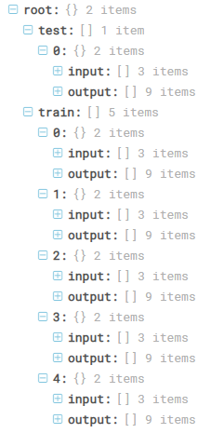
Data
Three folders: Train, Evaluate, and Test
400 Tasks is Train folder, 100 in both Evaluate and Test folders
Each Task contains a set of training data and testing data
Training data contains 3-5 pairs of train inputs and outputs and a single test input

Slide 4
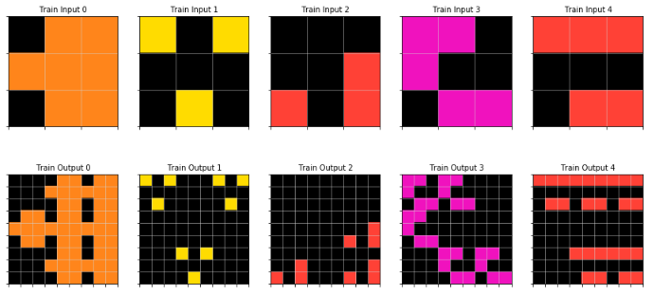
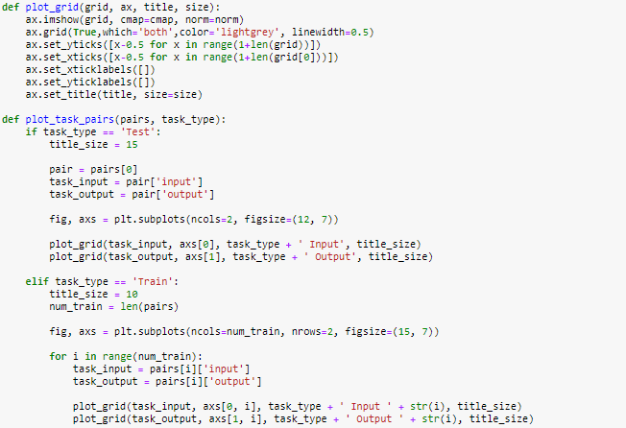
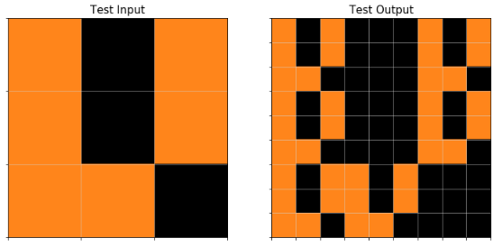
Data Wrangling
File: 007bbfb7.json Task Visualization

Slide 5
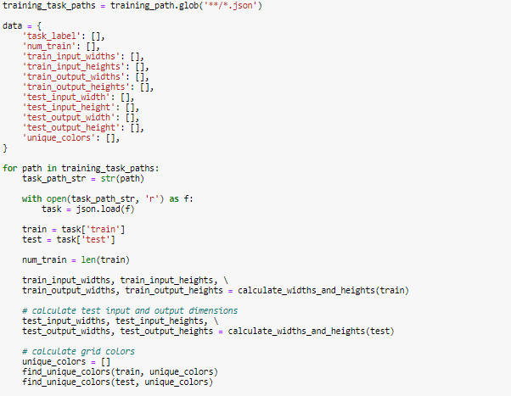
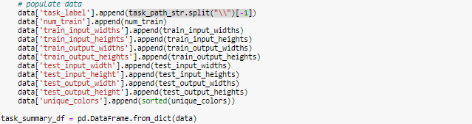
Data Wrangling
Script used to generate summary dataframe
Created columns for widths and heights of training and testing data as well as a column describing which values(colors) were included in the task.

Slide 6
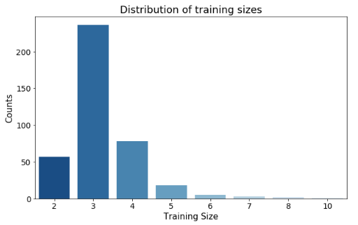
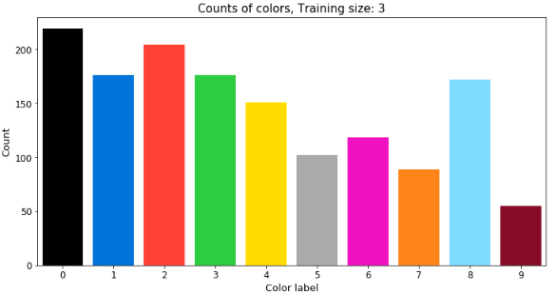
Data Analysis
Majority of tasks had 3 input and output pairs
Very few had more than 5 pairs
The frequency of colors were plotted based on size of training set

Slide 7
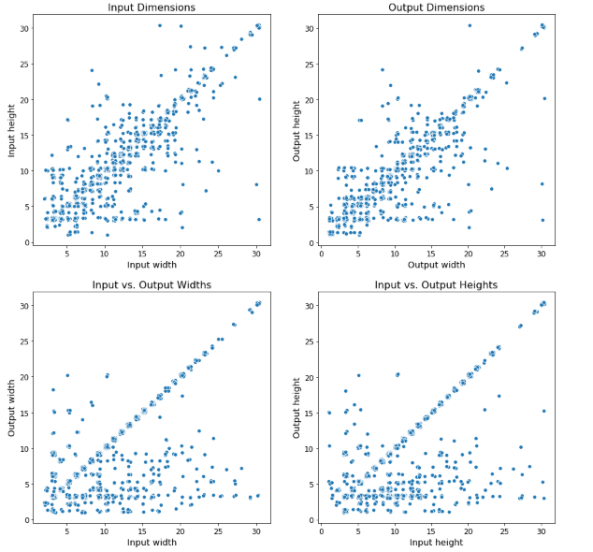
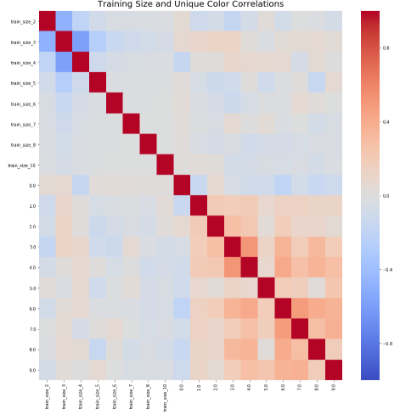
Data Analysis

Slide 8
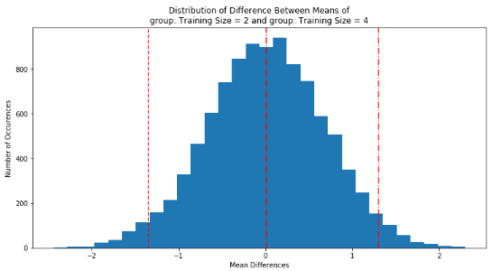
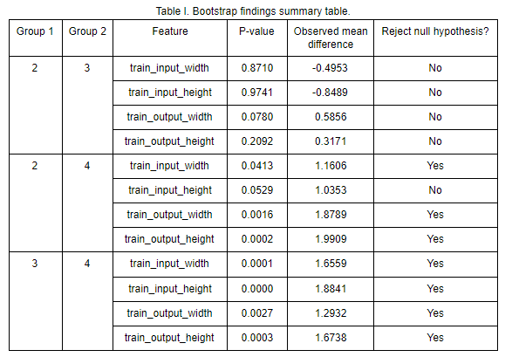
Data Analysis
Three largest groups were analyzed:
Training size = 2
Training size = 3
Training size = 4
Bootstrapping used to check the differences between dimensions of groups
Findings:
Groups with 4 training input and output pairs tended to have slightly larger dimensions(grid sizes)
Group with 2 training input and output pairs had slightly smaller input dimensions
Output width and height grew as size of training inputs and output pairs did

Slide 9
Model Building
Challenges:
Varying input and output sizes
Very few training samples per task compared to typical model building problems
Very difficult to generate new data to solve challenge 2
Solutions:
Pad inputs and outputs to a standard size varying with each task
Select models capable of learning using very few training samples
Write script to generate and retrain model repeatedly for each task

Slide 10
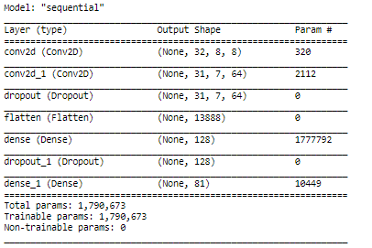
Model Building
Convolutional Neural Network (CNN)
Due to the nature of the data (grids), it is reasonable to consider using a CNN to solve this problem.
Advantages:
Good for image data, grids can be considered images
Feature learning and extraction, potential to learn patterns and relationships between grid cells
Memory efficient, with the task of building 400 models for each training task, this is very important.

Slide 11
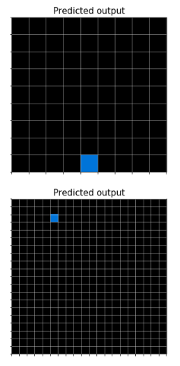
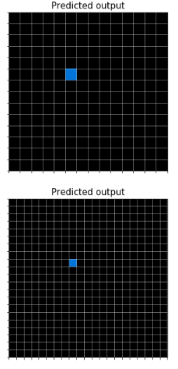
Model Building
Results
Model was unsuccessful in learning the patterns.
Causes:
Small training size
The range of abstract rules is large, each potentially requiring a specific architecture.
Architecture is too simple.

Slide 12
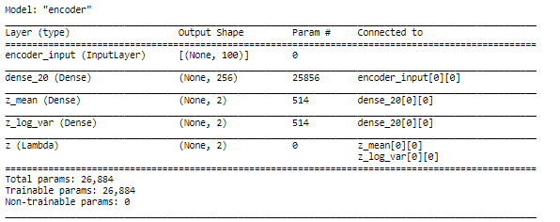
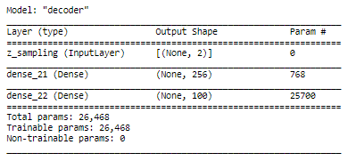
Model Building
Variational Autoencoder
Made of encoder and decoder
Typically used to generate new data by sampling input space.
May be able to capture underlying distributions which describe each pattern

Slide 13
Conclusion
Takeaways
Extremely difficult task, which is why it hasn’t been solved yet!
Convolutional network has potential, but likely requires a more complicated architecture than the one attempted
Challenge is creating a model that can be retrained multiple times and learn quickly. If successful, will improve capabilities of many modern machine learning applications.

